Slide 1
The feasibility and positive effects of a customised videogame rehabilitation programme for freezing of gait and falls in Parkinson’s disease patients: a pilot study
Journal of NeuroEngineering and Rehabilitation 2018
Impact Factor: 3.582

Slide 2
Introduction
1. Parkinson’s disease (PD) is the second most common neurodegenerative disorder and freezing of gait (FOG) and postural instability with falls occur in about 50–75% of patients.
2. Recent studies have suggested that virtual reality training produces short-term benefits on gait, balance, activities of daily living, cognition, quality of life.
3. Game allows training with an amusing and enjoyable approach, that can be performed at home with increased training frequency and/or on demand.
4. We propose a virtual reality training system to treat gait and balance disorders of PD patients according to recommended physiotherapy programmes for PD patients with high amplitude and fast movements, combined with visual and auditory cueing.

Slide 3
Methods
1. Participants
(1) Between June 2015 and May 2016, ten people with PD (mean age: 64.2±6.1 years, 5F/5M).
(2) Inclusion criteria:
(a) Diagnosis of PD.
(b) Age below 71 years.
(c) Disabling FOG and/or falls despite optimal drug treatment and subthalamic deep-brain stimulation (丘
脑下核深部电刺激).
(3) Exclusion criteria:
(a) Dementia (Mini Mental State Examination Score<24).
(b) Inability to maintain upright posture or walk independently.
(c) Patients suffering from other pathologies affecting gait and balance.
(d) Severe medical conditions that prevented assessment.

Slide 4
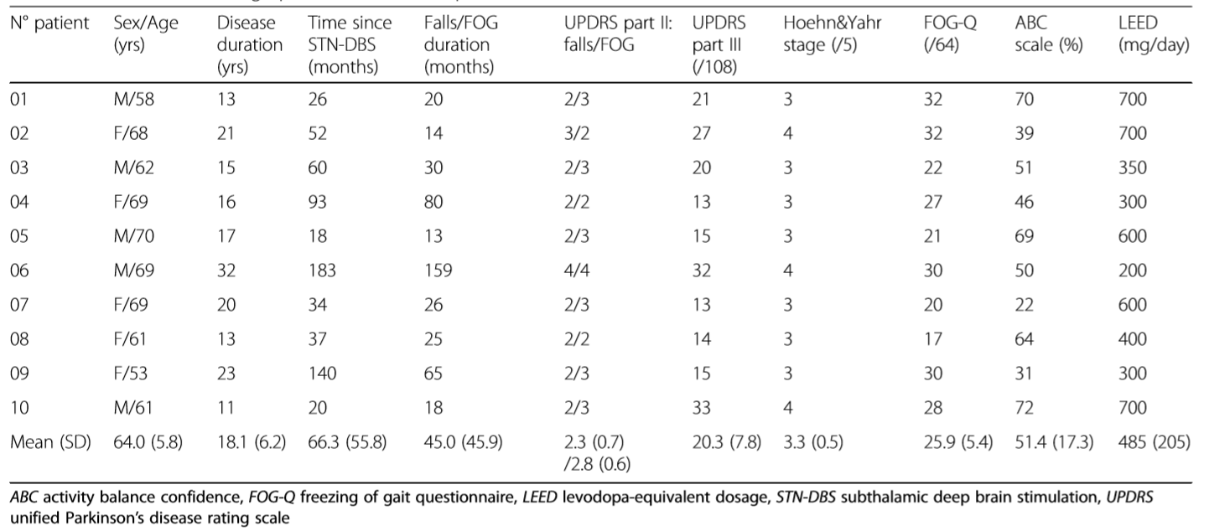

Slide 5
Methods
2. The ‘Toap run’ videogame
(1) Hardware: a laptop, a high definition television screen, a Kinect camera.
(2) Scenario: Garden, Mine cart and Surfboard.
(3) How to play: Patients need to perform movements according to visual cue to collect coins and avoid obstacles. Auditory cueing consisted of rhythmic music that beats in relationship to the velocity of the avatar displacement.

Slide 6
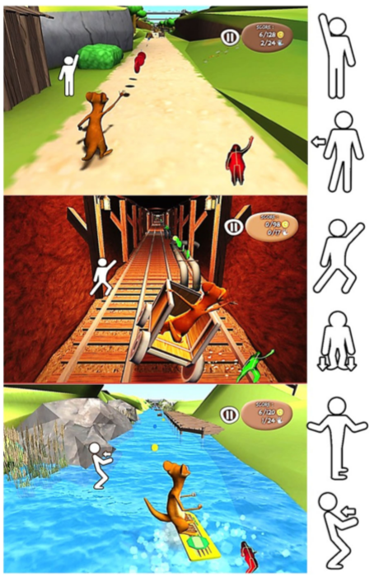

Slide 7
Methods
3. Procedure
(1) 18 training sessions with the ‘Toap Run’ videogame over a period of 6 weeks.
(2) The physiotherapist was instructed to increase the rhythm, number and complexity of movements to obtain a session of at least 40 min duration after the 9th session.
(3) Clinical assessments at inclusion (before the first training session), after the 9th and 18th training sessions, and 3 months later.

Slide 8
Methods
4. Outcome measures
(1) Perceived interest (4 items, with scores ranging from 4 to 28).
(2) Perceived competence (8 items, with scores ranging from 8 to 56).
(3) Perceived difficulty (3 items, with scores ranging from 3 to 21).
(4) Acceptability (ranging from zero to 10).
(5) Positive affects using Positive and Negative Emotionality questionnaire (EPN-31).
(6) Perceived fatigue using Piper Fatigue Revised Scale (PFRS).
(1)~(6) was performed after the first training and once a week.

Slide 9
Methods
4. Outcome measures
(7) Motor disability using UPDRS part III.
(8) Gait and balance scale using GABS part-B.
(9) FOG using FOG-Q.
(10) Fear of falling using Activity Balance Confidence (ABC).
(11) Activities of daily living using ADL-UPDRS part II.
(12) Quality of life using Summary Index of the Parkinson’s Disease Questionnaire (SIPDQ).
(7)~(12) were performed at inclusion (before the first training session), after the 9th and 18th training sessions, and 3 months later.

Slide 10
Methods
4. Outcome measures
(13) Anteroposterior APAs (重心转移距离).
(14) APAs duration (重心转移用时).
(15) Double duration.
(16) Step length.
(13)~(16) were performed at inclusion (before the first training session), after the 9th and 18th training sessions, and 3 months later.

Slide 11
Methods
4. Outcome measures
(17) Game performance.
(18) N. of movements.
(19) Game duration.
(17)~(19) were performed after each session.

Slide 12
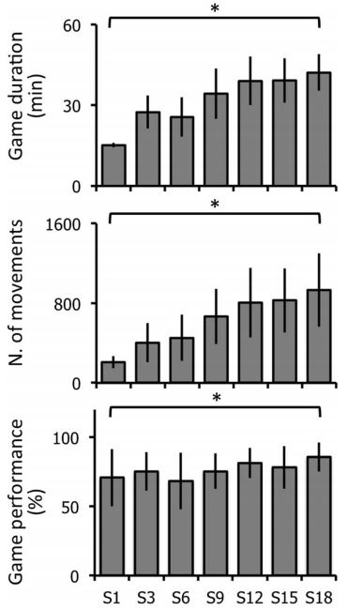
Results
1. Game duration, number of movements, and the game performance increased significantly between the first and 18th session.

Slide 13
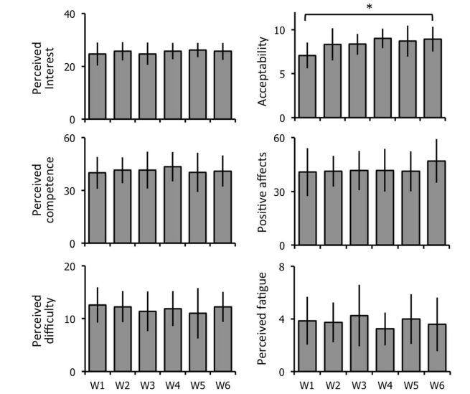
Results
2. General acceptability increased significantly over time, but other measurements of feasibility were stable over time.

Slide 14
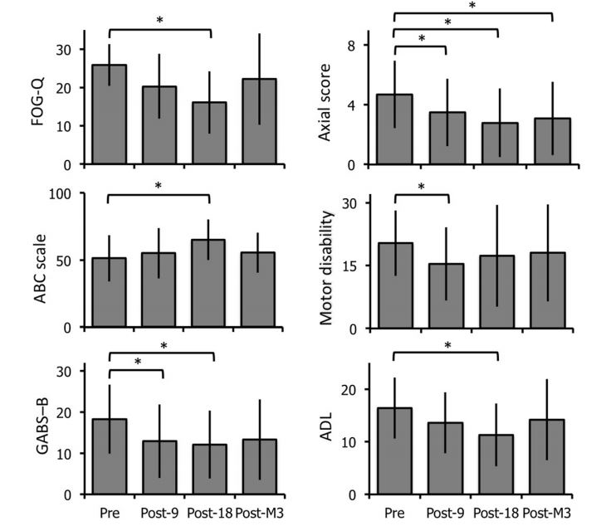
Results
3. After the 18th session, FOG-Q, GABS-B, ADL and ABC scale had significant change, which did not last for 3 months.

Slide 15
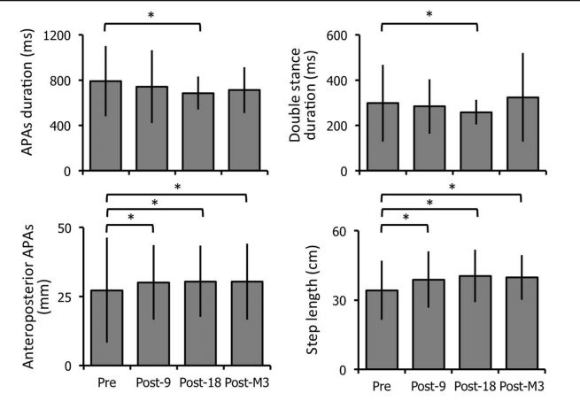
Results
4. The anteroposterior APAs and step length were also significantly higher after the 18th session and 3 months later, compared to baseline .

Slide 16
Discussion
1. Severe pneumonia (肺炎) occurred in one patient (P02) and a deep brain stimulation generator replacement was required in two patients (P06 and P09).
2. Improvement in gait and balance disorders could be transferred to increase activities of daily living competence.
3. The fact that the benefits of videogame training dissipate over time, as reported in other physiotherapy trials in PD, confirms the need of sustained exercise training in PD.
4. Limitations:
(1) Training was performed at the institute and not at home.
(2) We did not specifically examine the effects of our videogame rehabilitation programme on cognition.

Slide 17
Conclusion
1. Rehabilitation based on a customised videogame to treat gait and balance disorders of PD patients is feasible, well accepted, and may be effective.
2. Our study confirms the need of sustained exercise training in PD.

